Slide 1
Atos Response
Manulife SLX to MPS migration RFI
22nd November 2021
22th November 2021

Slide 2
Agenda
1
Solution Summary &
Atos Value Proposition
5
Governance and Engagement Model
2
Understanding of requirements
6
Indicative Profiles
3
Execution Approach
7
Atos Credentials
4
Proposed Solution – Data Migration, Enhancements, Features & Customizations, Process Automation, Testing

Slide 3
Atos Solution Summary
Execution Timelines
Migration and Implementation Costs
Quality and User Satisfaction
Performance and Scalability
Atos Solution Highlights
Objectives
Benefits
Due diligence of data, process workflows, data field mapping and feature available on SLX and MPS applications, to create detailed requirement document for the migration and firm up our pricing
Proven data migration approach and tool-based data validation at target MPS environment
Phase-wise approach to enable parallel execution of Data migration and Application enhancement.
Agile based approach for implementing SLX features on MPS
Leverage Atos Process Recorder to analyze processes to determine potential automation like straight through processing (STP) opportunities
Ready to deploy ‘A’ team including Data Architects, Life and Pension domain experts, Program Managers and Scrum Masters
Proven expertise in consolidating large policy admin platforms for Life and pension customers
Migration of SLX application data to MPS
Implement SLX application features on MPS
Identify process automation opportunities on MPS
Lower TCO by consolidating all plans in MPS platform
Risk free and tool-based data migration
Lower cost, faster execution
Seamless collaboration between SLX and MPS SMEs
Robust Governance and committed outcomes
Enhanced customer experience
End to end ownership of migration enable smooth decommissioning of SLX application

Slide 4
Atos Value Proposition
Certainty; Domain Credentials; Program Flexibility; Tools
We understand Manulife’s business
15+ years of engagement with Manulife; In depth understanding of Manulife’s retirement business and processes;
Proven system and data migration of cross platform/ technologies in life & retirement areas
Experience in Policy Admin consolidation, Lift and Shift Pensions Portfolio operations at Global Insurers
Resource Readiness
Senior Program Managers to spearhead the overall SLX migration program;
Certified expertise on life and pensions domain;
Skilled Data migration experts across different levels available for immediate deployment in US and India
02
Risk mitigation through governance and program management
Efficiency and certainty in migration process with proven best practices
01
03
04
Mitigate Risks , Program flexibility
Ready to use Templates & Checklists;
Atos Lessons learnt to bring in efficiency, certainty and to speed up execution;
Atos understands potential risks and have mitigation strategy
Program flexibility to align with Manulife; Be on the journey together with understanding of pros and cons as choices
Accelerators
Atos accelerators (Data Validator, Data Modernization Toolkit) for accurate and risk-free data migration, process automation

Slide 5
02.
Our Understanding of Requirements

Slide 6
Atos Understanding of Manulife Requirements
SLX and MPS both support Canada retirement business only
Manulife is looking forward to retire SLX and migrate data/ functionality to MPS
Manulife has already executed 11 blocks of conversion (simpler products and smaller policies), converted 652 clients, 12,868 members
Approx. 1650 clients and 679,045 remaining members on SLX need to be migrated to MPS
Internal users are about 1000 for each system, potential external users are about 1.5M for MPS and 700,000 for SLX
Product types: IO, IPP, NRIO, RRSP, TFSA, RPP, Non-reg (supported by existing conversion process)
Product types: SPP, Non-reg (full analysis to verify for gaps to be done), EPSP, Stock, Unclaimed property, PIF, RIF, RCA, Notional SERP, Advantage (conversion process to be extended to support)
Source DB – Oracle 19c ; Target DB – SQL Server 2016
Data size : 3TB
Current environment is available 24x7x365 with outage windows between midnight and 8am on Sunday mornings
Portfolio Facts
Manulife Challenges
Manulife Requirements
High TCO – need to maintain both MPS and SLX systems
Different data models at SLX and MPS – making data mapping and migration very complex
Looking for partners to either revamp/ enhance and scale up existing processes or develop new processes for SLX data migration
[SCOPE 1] Complete data migration from SLX to MPS – Expects perfect/seamless conversion with no disruption
[SCOPE 2] New features and enhancements to MPS so that it is at par or better than SLX.
24 features only on SLX (8 high & 16 low priority features)
21 features better on SLX vs. MPS (12 high, 9 low priority)
[SCOPE 3] Customizations for large clients – This includes customizations for the top 25 clients from SLX
[SCOPE 4] Process automation like STP

Slide 7
In-Scope, Out of Scope
[SCOPE 1] Data Migration
3 TB of Data Migration along with respective schema from SLX to MPS
Data will include Plan, member info, policies and financial info
Data transformation including business rules, triggers, sequences, views and stored procedures
Data validation on SQL staging and on production after transformation
Data profiling and data cleansing
[SCOPE 2 & 3] Features Enhancement & Customizations
Application Development and Unit Testing; Deployment
Customization – Large Clients
ContrastSecurity to address security vulnerabilities in code and protect applications against attacks.
Sonarqube, Fortify tools to improve the code quality
Post Warranty Support for the agreed warranty period.
Testing
Data Migration Validation & Testing- SLX to MPS
Functional/System Testing- MPS enhancements & new features
System Integration Testing- MPS enhancements & new features
Regression Testing (Manual + Automation)- MPS
Performance Testing- MPS ; Parallel testing – SLX
Test Data Management/Creation-MPS
[SCOPE 4] Process Automation
Analyze SLX & MPS processes for STP – Change banking information, Target Age/Investor profile change, Beneficiary changes
Data Migration
SQL staging server provisioning
User profiles migration
Features Enhancement & Customizations
User authentication and Role based access control
Production Support beyond Warranty Support
Testing
Security Testing
Accessibility Testing
General
Vendor co-ordination (for any up-stream/downstream impacts).
IN-SCOPE
OUT-OF-SCOPE

Slide 8
03.
Execution Approach

Slide 9
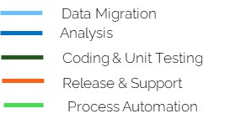
SLX Migration – Implementation Roadmap
Legend
M0
M2
M4
M6
M8
M10
M12
M14
M16
M18
M20
M22
M24
Planning
Due Diligence
Schema & Data extraction
Data Migration
DB Design & Data Profiling
Migration to Stage
Data validation
Migration to Prod
Warranty support
Feature Enhancement Phase-1
Feature Enhancement Phase-2
Feature Enhancement Phase-3
Feature Enhancement Phase-4
Customization Phase-5
Analysis and test strategy
Test env setup
ST, SIT
Regression
Performance Testing
Testing
UAT Support
Process Automation
Planning
Use Case Implementation
Process Analysis

Slide 10
Due Diligence Approach
Week 1
Week 2
Week 3
Week 4
Week 5
Week 6
Week 7
Week 8
Week 9
Week 10
Phase
Planning
Detailed Analysis of SLX and MPS applications
Assimilation of knowledge components
Due Diligence
Final Submission
Dependencies on Manulife
Finalize due diligence plan
Finalize schedule for meeting Manulife SMES (Business and IT)
Acquire access to systems and artefacts required for the assessment
System Access and SME familiarization
Tool Set-up
Analysis of SLX/MPS processes:
ACQUISITION / PROPOSAL: Pre-sale / Post sale transaction, Plan design, Sale, Management, Pricing
ONBOARDING: Data entry, Map funds/Reconcile, Payroll data, Issue resolution, Enrollment, Plan sponsor/Advisor interaction
SUPPORT AND SERVICES: Trading, Service operations, Products, Services, Transactions (Contribution, withdrawals, loans, transfers), Reporting, Statements, Compliance and Testing
ACCOUNT TRANSITIONS: Retention, Expansion
Analyze SLX and MPS process workflows, existing reports, database
Analyze SLX & MPS test asset/ repository, test environment
Analyze additional SLX features that are to be implemented on MPS
Identify data components, workflows required to implement SLX features on MPS; Analyze processes that can be automated
Gather all the information collated during due diligence
Revise SLX data migration approach and re-calibration of migration tools
Mapping of SLX data fields in MPS system and resolve any data mapping and data conversion issues
Refine data migration schedule based on Manulife priorities
Detailed Agile sprint schedule for all the features implementation in scope
Present Atos project plan to Manulife for approval
Fine tune the solution approach based on Manulife suggestions
Access to SLX and MPS applications and any documentation, if available
Detailed database Architecture including ER relationship diagram , DB stats , DB objects, Entities
Provide SMEs for inputs, clarification, query resolution
Review and Sign-off due diligence report, solution approach and project plan
Activities
Deliverable
Approved diligence plan
Team onboarded for the due diligence
Detailed Assessment Report for Databases, workflows, additional features and reporting requirements
Tables/components categorization Report including Business Rules, Complexity, Data Mappings, Data Dependencies and Volumetric Analysis
SLX & MPS existing test asset availability report
Understanding document on existing conversion tools (like BTP)
Fine-tuned migration solution
Identification of re-usable components
Refined project schedule and estimates
Finalize and freeze the application enhancement scope
Process automation scope
Signed-off migration approach: Solution & Waves
Signed-off on Business requirement

Slide 11
Due Diligence – SLX Critical Areas
Sample due diligence questions
Manulife have any preference/sequencing to be considered for implementing functionality in MPS? Estimations and schedule will have an impact if the phases 1-4 are not in the recommended order. Is there any preference in data migration (Phased approach by Product, features, etc) ? When will Manulife have the Conversion/confirmation from client/plan sponsor to migrate into MPS product. Will SLX client/plan already exist in MPS? Do we need to merge or create second plan on MPS? Are there any application updates/enhancements to support single view of multiple plans for same plan sponsor or participant ? SLX and MPS : application architecture : SLX Product to MPS Product mapping and SLX Product to MPS Data, product & features. Mapping of SLX data fields in MPS system and mapping to business workflow. This will resolve any data mapping and data conversion issues. Can we leverage the SLX & MPS demo account for migration and production validation testing, before migrating actual customer (for each product). Mapping of Up/downstream applications from MPS and any co-ordination with vendor required. Need to setup : Dev, QA and Stage environments with 25% of production volume. Need to setup (masked) production volume data in stage/test region for performance testing. Do we have masked test data available for on/offshore to work on? Details of Regression, performance testing and application coverage Access any current challenge with performance of MPS applications or databases? Access to SLX/MPS DB for detailed analysis or Detailed DB Architecture including ER relationship diagram , DB stats , DB objects , entities. Documentation/Knowledge on existing data flow tools currently used by Manulife - will be used for mapping and transformation exercise Collaboration with Manulife Business team for data categorization, finalizing the mapping source/target & transformation rules for data migration Dedicated Staging Database and Applications pointing to Staging Database for data/application validation

Slide 12
04.
Proposed Solution – Scope 1- Data Migration

Slide 13


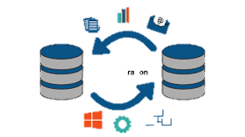





Data Migration Solution – Option 1
With Informatica
Analysis
Assessment
Tool Enhancement
Mapping
Data & App Validation
Production Move
Customer Notification
MPS APPLICATION ENCHANCEMENT FOR DATA MIGRATION
Business
Acceptance Testing
Data
Validation
MPS
SLX
Load staging
Staging DB
(Transformed SLX data)
Policy-Plan
Client
Enhanced In-House tools
(BTP, Client Print Process, etc.,)
Feeds
Customer
Member
Member
Financial Info
Financial
Others
Others
Excel or SQL SERVER DB
Go-Live data to MPS
Data Transformation & Mapping DB
Closing the Plan in SLX
KAFKA DATA INGESTION OR INFORMATICA FOR DATA SYNC
SLX Data Environment
DATA MIGRATION (PHASE OR BULK)
MPS Data Environment

Slide 14






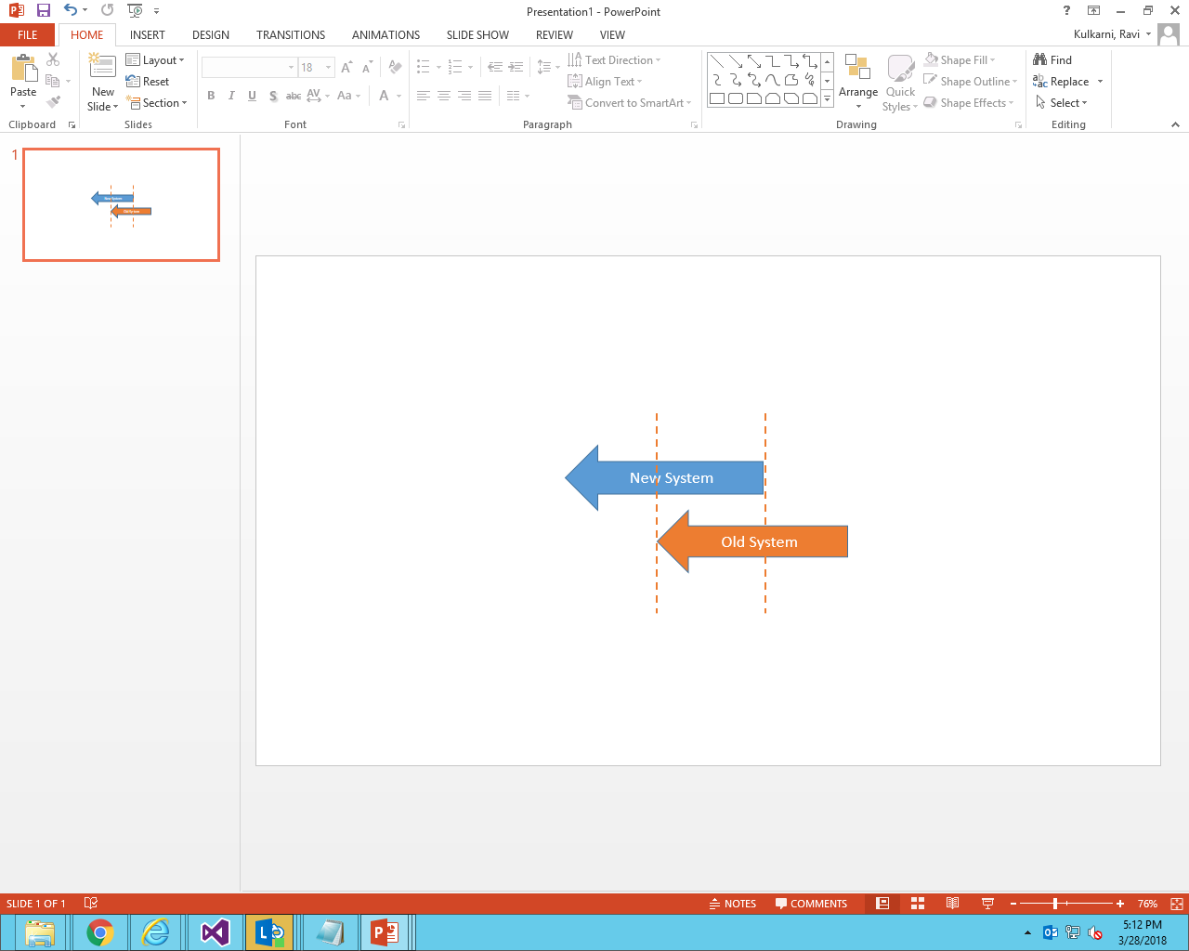
Details of Proposed Methodology - Option 1
With Informatica
1
2
3
4
Data Engineering
Data grouping and classification
Products / Features mapping
Client Plan mapping
Plan group mapping from SLX to MPS
DB plans from SLX to MPS
Member/Member Plan mapping
Financial calculations/modifications if any , mapping etc.
Investment/Fund Mapping
Data assessment & mapping
Application Assessment
Document known issues , scope, plan etc.,
Create Migration Strategy
ETL Design & Build
Identify tools for Migration
Refine high level design
Create high level acceptance plan
Create testing strategy
Design data Migration as a separate thread
Make use of existing process like BTP, Plan Group Name process, Client Print Process, Member non-financial process, Financial process developed by Manulife
Build transformation rules in ETL Tool
Create staging Database with MPS skeleton
Create flags for data ready for Migration
Preparing reports for data readiness and migration statistics
Staging data validation
Apply DB enhancements if needed for data Migration
Data validation and reporting
Application validation for migration data on Staging Database
Business Acceptance Testing
Flag set for completed validation data
Application enhancement testing on the migration data
Confirmation of data movement to MPS platform
Production Movement
Identify the production movement window
Plan for outages if any
Movement of confirmed data from Staging database to MPS platform
Application/DB Code deployment as part of application enhancement
Live Testing and decision confirmation
Enable rollback flag for migrated data
Rollback flag to sync data from MPS to SLX and vice versa if any
P
User Sign-off
P
P

Slide 15


Data Migration Solution – Option 2
With SSMA and SSIS
SLX
System
Schema Extraction
AS-IS SQL Staging
Database Re-design
SQL Staging
MPS
System
Database Structure
Data Types
Validation
Bug Fixes
Validation
Bug Fixes
Database Properties
Data Profiling
Policy-Plan
Client
Schema Mapping
Business Entity Mapping
Customer
Member
Data Extraction
Integrity Mapping
Character set Mapping
Member
Financial Info
Data
Extraction
Verification
Staging DB
Data Type Mapping
Staging DB
Rules Extraction
Financial
Integrity Validation Check
Others
Others
Column Default Values
Bug Fixes
Bug Reporting
Data Loading
NULL/ NOT NULL checks
Data Loading
Using SQL Server Migration Assistant
Transformation

Slide 16
Details of Proposed Methodology – Option 2
With SSMA and SSIS
1
2
3
4
Analysis and Discovery
SLX data environment analysis
Tool setup
Review data complexity and quality
Review stored scripts and rules
Revise estimations & solution if needed
Business Sign-off
Data Migration
Multiple instances run of SQL Server Migration Assistant tool
AS-IS schema and data migration to SQL staging environment using SQL Server Migration Assistant
Preliminary check
Staging data validation
Data Validator tool setup
Data validation
Bug fixes
Source and Target Mapping
Data cleansing & validation report
Transformation
Create SSIS package for update/modify data & database objects
Data profiling
Create business rules
Migrate data into MPS
Report creation/updates
GO LIVE & Warranty Support
Deployment to Production
Warranty support
User Acceptance Testing
UAT Support
Defect resolution
Testing & Parallel Run
Run SLX and MPS systems together
Validate results, reports and bug fixes
7
6
5
P
User Sign-off
P
P

Slide 17
Data Migration – Solution Options
Comparison and Recommendations
Option 1 – Informatica based migration
(Atos Recommended)
Option 2 – SQL Server Migraton Assistant
(SSMA) based Migration
1
2
Solution Elements:
Data Engineering – Analysis, mapping and transformation
ETL Design & Build – Development of ETL.
DB/application enhancements
Staging DB Validation
Production Movement
Solution Elements:
Discovery (assessment of source systems)
Migration – Use SSMA tool to As-Is migration to SQL server.
Transformation – Using SQL scripts and SSIS packages transform the data
Data validation
UAT and Go-Live
Accelerated data migration
Best options to migration data between 2 different databases (Oracle to SQL server)
Leverage of Manulife Migration Tools
Proven methodology for such data migration in Manulife
Less storage while doing data migration
Enable batch mode for data migration
From month 5, can start the new feature development
Marginally higher TCO
Benefits to Manulife

Slide 18
04.
Proposed Solution – Scope 2 & 3 - Features Enhancement and Customization

Slide 19
Scope 2 & Scope 3 – Features Implementation
Approach, Solution, Grouping
Grouping
Focus on Sponsor Site(Contribution Online, General Website and Online Reporting) & Product Site(Stock, Product and Gro)
High Priority Business Functions with less dependency on data migration
New/Enhance | Page | End User | High | Low | Grand Total
Phase 1 |  |  | 10 | 3 | 13
Enhance | Member Site | Participant | 1 |  | 1
Enhance | Sponsor Site | Plan Sponsor | 3 | 1 | 4
Enhance | Product | Special | 3 |  | 3
New | Sponsor Site | Plan Sponsor | 3 | 2 | 5
Phase 2 |  |  | 5 | 4 | 9
Enhance | Member Site | Participant | 1 |  | 1
New | Advisor Site | Advisor | 1 | 1 | 2
New | Member Site | Participant |  | 3 | 3
New | Sponsor Site | Plan Sponsor | 3 |  | 3
Phase 3 |  |  | 4 | 9 | 13
Enhance | Member Site | Participant |  | 3 | 3
Enhance | Sponsor Site | Plan Sponsor | 4 | 3 | 7
New | Member Site | Participant |  | 1 | 1
New | Sponsor Site | Plan Sponsor |  | 2 | 2
Phase 4 |  |  |  | 10 | 10
New | Advisor Site | Advisor |  | 1 | 1
New | Member Enrollment | Participant |  | 4 | 4
New | Member Site | Participant |  | 3 | 3
New | Sponsor Site | Plan Sponsor |  | 2 | 2
Phase 5 |  |  | **7 |  | **7
Enhance | Large | Large | **7 |  | **7
Phase 1
Focus on Sponsor Site(General Website, Analytics and Investment Information) & Advisor Site(Reporting and Sales)
Next Level High Priority Business Functions with data migration dependency
Phase 2
Phase 3
Focus on Sponsor Site Reporting Functionality(Online Reporting)
Next level Priority Business Functions
Phase 4
Next Level Low Priority Business Functions
General Functionality that are independent
Phase 5
Customization to Large Clients: This includes customizations for the top 25 clients from SLX

Slide 20
04.
Proposed Solution - Scope 4 – Process Automation

Slide 21
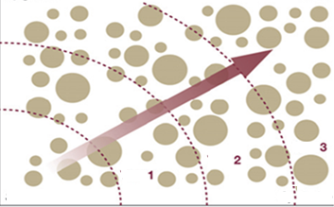
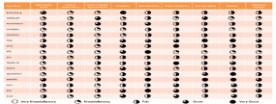

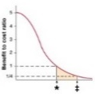
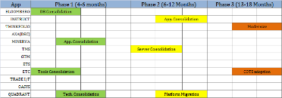
Atos’ Process Assessment Framework
Process Clustering
(Stage I)
Process Evaluation
(Stage II)
Decision Making
(Stage III)
Implementation Roadmap
(Stage IV)
Sample Processes
Evaluation Parameters
FTE Saves Analysis
Business Areas
Add change Banking Info
Heat Map
Business Priority Scoring
W4
Investor Profile change
User Experience
Redundancies in Process
Volume
Avg. Handling Time
Business Criticality
Technology Feasibility
Process Reusability
W3
Plan Sponsors
Beneficiary Change
W2
Advisors
W1
Process Inventory
Participants
Contribution
Online Reporting
Cost Benefit Analysis
Implementation Roadmap
Enrollment
Member Site
Beneficiaries
Others…
Others
LEAN Opportunities
Process Recorder
Automation Processes
Process Maps, BPMN, Time-in-Motion
BPO Opportunities
Notes:
Syntel’s Process assessment framework is a scientific methodology to identify processes for automation. We leverage our Process recorder tool, to accelerate knowledge gathering and generate Business process models, Time-in-Motion and Process Maps.
Heat Map of processes clustered in waves is delivered along with implementation roadmap. Quick wins are taken-up in the initial wave and complex processes in subsequent waves.

Slide 22
IP: Process Recorder Intelligent Recording and Process Mapping
Intellectual
Property
Data Enrichment
Features
Capture
Annotation
Override application name, screen names and Platform description
Record user actions for a particular workflow
Assign meaningful captions to each screens
Technology agnostic
Study as-is Process and environment
Automation feasibility, complexity and effort estimates
Business Output
Noise Reduction
Activity Maps
Visio Maps
Time & Motion Metrics
Keep only relevant screens (captures)
Data Masking
Generate Outputs
Mask the sensitive information in the workflow
Business & Technical Outputs
Technical Output
Recording
Clean up
Outputs
BPMN
Tech. Signatures
Automated, Non-invasive Process Capture | 100% Coverage | Significant reduction in due diligence cycle time

Slide 23
04.
Testing - Approach

Slide 24




Approach - Data Migration Testing
SLX- Source
Oracle Database
MPS
Staging Database
Tool based Validation
MPS- Target
SQL Server
Data Analysis & Mapping
Data validation
Schema/Data extraction
Customer
Organizations
ETL Rules /SQL Queries Validation
Plan
Clients
Policy
Members
Clients
Member
Entities
Rules Transformation
Parallel testing – SLX & MPS
Plan
Policy
Financial Data
Financial Data
SQL Server Migration Assistant
SQL Server Migration Assistant
KEY TESTING ASPECTS
SLX DATA & ETL VALIDATION
STAGING – SQL QUERIES/ DATA VALIDATION
MPS & DATABASE VALIDATION
Schema / Data Mapping Validation
Validation of:
SLX Data extracts & Data Mapping
Data formats and business rules used for processing/ transformation
Correctness and completeness of the transformed data based on rules
Referential integrity , indexes, col names, links etc.
Uniqueness of master record set & presence of duplicate values
Count of master record set in SLX
Validation of:
Data count in staging databased based on SLX source data- (Comparison) – if As –is
Validation of SQL queries if data transformation is done using MMSA
Duplicate, Missing & Deleted Records
Calculated fields based on source data
Data reconciliation between SLX & Staging database to ensure correct data load.
The exception records in the SLX & staging database
Validation of
Reconciliation of data for the initial, & incremental load based on final reports.
Data comparison Staging & MPS (if SSMA)
Understand functionality and data parameters
Create optimized test data
Create test scripts and bind data
Run Parallel tests – validate response and database for both SLX & MPS
Run Performance tests to validate the performance based on volumetric
ETL /SQL Testing Transformation Logic
Validating the Initial & Incremental Load
Parallel Testing- SLX & MPS
Performance Testing

Slide 25
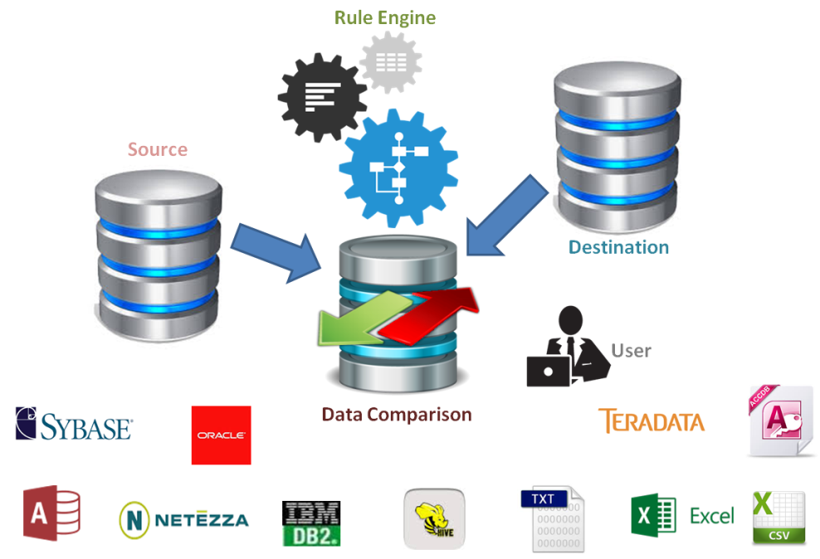

Data Validator – Key Features
Supports Multiple Databases
Data Validator can connect and read the data from RDBMS, Cloud Databases, Hadoop Data Stores, Flat Files, Fixed Width Files, JSON, XML
Transform Rule Engine
Data Transformations during Data Migration process can be validated using build in Rule Engine by building Customized rule
Dashboard
Reusable Configurations
The query files and data source configuration settings can be used for multiple executions
Dashboard and Reports
Exclusive customizable dashboard for more detail and user-friendly reporting. The report can be exported in Microsoft Excel format

Slide 26

Approach – Features Enhancement Testing
Parallel/Baseline testing
based on SLX Functionalities
Policy Plan, Member info, Fund Investment
Functional/Batch Testing
Online Contributions, Investment information, Online reporting, Online withdrawals
Interface Testing
Testing the interfaces and data flow from one module/system to other integrating systems
Features
New Implementation
1
2
3
Enhancements
Test Data Management (TDM)
Identify Test Data Requirement for scenarios
Selenium & excel based macros for test data generation
Test data needs
Member details, Policy Data, Plans, Customer organization, Financial data
Release Notes
Change Pack
7
5
4
Acceptance Testing (support)
Plan and validate business scenarios
Test Data Support
Business user agrees and certifies
Regression Testing
Existing other MPS test scenarios based on impact
New MPS features & enhancements test cases based on frequency
End to End Integration Testing
Upstream/Downstream Applications integrating with MPS
Third-party/Vendor Application extracts
Performance Testing
High Volume MPS Transactions
Load, Stress & Performance testing
Database performance
6
Automation

Slide 27









Regression Testing Approach (Manual + Automation)
MPS Feature Enhancements
MPS Existing Test Scripts +
New Features/Enhancements
(Functionality validated & stable)
Manual + Automation
MPS Component
Identify MPS individual components for Automation
Parameters
Execution Summary
Functional Complexity
High Data dependence
Integration
Report
Test Script
Process Interdependencies
Automation Feasibility
Build test scripts for key regression Suit (Selenium, UFT)
Final MPS Regression Repository
Iterations
MPS New Enhancements
MPS Business Criticality & Impacts
MPS Prioritized regression test suite
Execution
A
Test Suite
Risk Based
Run Automated & Manual Scripts every release/hotfix
Build automated scripts for components- (Selenium, UFT)
B
Test Data Management
Analyse and choose the end-to-end critical business flows test cases
Automation Enablers
Automated generation of test data database/Manual
Optimized MPS Regression Inventory (Manual +Automation)

Slide 28
Approach -Performance Testing
Requirement Analysis & Planning
Analyze non-functional Requirements
Identify MPS critical transactions/scenarios
Understand the MPS technology stack
Determine Testing Types : Baseline test. Load, Stress & Performance
Define SLA along with Manulife
Test Environment Setup
Install and configure JMeter/Storm-runner in MPS Test Environment
Configure performance monitors
Ensure test bed readiness with required data
Performance Test Scripting
Create / Customize test scripts to support multi-user execution
Build Test Sets and Load Profiles
Dry run the script
Define scenarios based on Volumetrics
Performance Test Plan & Performance Test Matrix
Test Environment and Test Data Setup
Performance Test Scripts
Non functional requirements
* Members viewing transactional history
1
2
3
Defect Reporting
Deliverables
Test Scenarios
4
Performance Test Plan
Business process flow documentation
Base-lined Performance Test Script
Preliminary Test Reports (for each test run)
Executive Test Summary Report
Execute Baseline test with minimal load and Benchmark the Performance
Performance
Sign-off
* Example scenario based on RFI scope
Test Execution
Configure the Test Run in the Controller
Run MPS transactions/ scenarios
Setup performance monitors & Diagnostics
Monitor and analyze the system statics and servers
Defect Fix
Execute Load test with varying load conditions and determine the application behavior under low, normal and anticipated peak load conditions

Slide 29
05.
Governance and Engagement Model

Slide 30
Atos Governance Model aligned with Manulife
Governance forum
Purpose
Attendees
Business Alignment
Quarterly
(Strategic)
Overall Program Progress
Alignment to Project Charter
Assess Risks, Budgets and revise program direction as necessary
Manulife: Program Sponsor, Program Director , Business Owner
Atos : Global Client Partner & Engagement Director, Program manager
Executive Review
( Manulife, Atos, 3rd Parties)
Program Governance
(Tactical)
Monthly Review over all program
Risk Mitigation and Issue resolution by Track
Team Structure and adjustment
Focus items from Atos & Manulife
Manulife: Program Director, Project Manager.
Manulife Business Rep. Architect
Atos: Program Manager, Track Manager/Leads, Engagement Director
Program Review
Delivery Management
Track Level Governance
(Operational)
Data Migration Track Review
Features Development track review
Process Automation track review
Issues/ Risks/ Blockers
Manulife: Project Manager(s), Application/ Product Owner
Atos: Data Migration –Track Lead, Features Development Leads, Process automation Leads, Scrum Masters
Delivery Governance
Status Meeting
Standups

Slide 31

Proposed Engagement Model
Qtrly Steering
Committee Meetings
Monthly
Governance
Meetings
Issue
Escalation
Matrix
Project
Governance
Model
Manulife
Executives
Strategic Direction
Atos Client Executive
Atos Engagement Director
SLA
Compliance
Reports
Steering Committee
Monthly Status
Dashboard
Governance Team
Wkly/Monthly
Status Reports
Manulife
Sr. Manager
Engagement
Management & Escalation
Delivery Manager
Manulife Team
Atos Onsite Team
Atos Offshore Team
Task Monitoring & Control
Manulife
Scrum Master
Project Governance
Project Lead
Scrum Master
Project Status
Issue Management
Metrics Reporting
Lead Developer
Business System Analyst
Operations Team
Technical Lead
Deliverable
& Sign-offs
Work Packages
Result Packages
Developer
QA Engineer, Tester
Manulife Business
SME
Data Architect
Business Sys. Analyst
Data Designer
Release Manager
Business Process
Operation Support

Slide 32




Sprint Execution – Onsite/Offshore Model
SPRINT 1
SPRINT 2
SPRINT 3
SPRINT...
SPRINT N
USA/Canada
Atos Scrum Master
INDIA
Sprint Planning
2
Sprint Backlog
Story Grooming
Dev & Test
Product Backlog Initialization
Dev & Test
MF PO
3
3
Project KickOff
1
Daily Standup
7
Product Backlog
Prioritization
4
Product Increment
CI / CD
5
Sprint Execution
Release Planning
Definition of Done
Demo per DoD
Sprint Retro
PO Rejects
SHARED DEVOPS – Cloud COE, Java Developer, Agile COE, Testing COE
6

Slide 33
Key Assumptions
Data Migrations
Testing
Enhancements and Customizations
Approx 200 tables are to be migrated from SLX to MPS
Assuming there are 100 stored procedures, 100 views, 50 triggers, 70 sequences and 600 business rules with below complexities:
Effort estimation may be revised post analysis phase
Data Validation tool will be used for validating data on SQL staging server
Any license, Software and environment setup costs will be borne by client
All the accesses to the respective environments will be provided to ATOS team by client in the analysis phases itself.
Existing SLX test cases covering the new features & enhancements would be made available for Baseline/parallel testing.
Existing Manulife tool stack for Test Management, Test Automation & Performance testing would be made available to Atos.
Any license, additional tools, Software and environment setup costs will be borne by Manulife
Test Automation has been considered for building automated regression suite.
Existing manual & automated MPS test scenarios to be leveraged for regression testing
Atos Data Validator or other third-party commercial tools such as query surge, Tosca Data Integrity will be leveraged for data validation based on feasibility.
Support required from Manulife to define the high-volume test scenarios/transactions for Performance testing.
45 functional requirements(24 new features and 21 enhancements) and Customization(Large Clients)
Web Enabled Application - Java Technology
Development/Testing environments and support staff will be provided by Manulife
Application DBA support will be provided by Manulife
Application solution architect or SME will be assigned by Manulife for 5-10% capacity

Slide 34
Typical Migration Risks and Mitigation Strategy
Migration Risks | Atos mitigation strategy
Project Execution\Planning | Ensure right stakeholders\decision makers\SMEs are involved throughout the project cycle. Avoid overlapping of core team between different streams.
Interfaces and Vendors | Up/down stream Interface dependencies should be identified and discussed. Aligning with Vendor on timelines and any changes happening on the Interface.
Gap in conversion scope | Due diligence phase will do the analysis of the SLX and MPS systems.
Data Migration execution | Tracking overall execution elapsed time as data volume increases (before Production deployment).
Data Loss | Data validation at each migration stage.
Data Corruption | SLX (Informatica) business rules vs MPS application capabilities
Semantics | Testing of schema mapping from SLX to MPS
Application Stability | Application functional, regression and performance testing
Data Validation\Review | Plan frequent data review with Business to identify requirement gaps. Using Prod like setup with migrated data to for Business Validations.
BIT and BAT testing | Ensure right stakeholders\Business involved in creating test plan and perform testing.

Slide 35
06.
Indicative Profiles

Slide 36
Indicative Profiles
Name / Role | Experience Description
Name: Avinash Bodkhe Role: Program Manager | Senior leader with 19+ years of experience in fast-paced IT & ITSM Environment. Motivated agile leader with strong organizational & prioritization abilities. Has managed portfolio of ~USD12M in earlier assignment. Areas of expertise include Client Engagement Management, Sales Cycle Management, Team, Capacity & Escalation Management, Project Planning & Execution, Risk & Software Delivery Management. Hands-on experience on all phases of the implementation lifecycle (SDLC) from strategy to support, managing end-to-end deliverables spanning into various IT domains & client engagements. Proficient on client engagement to understand their organization goals, business vision, strategies, pain areas, issues & procurement needs. Partnered with various product vendors to bring right solutions to the client. Managed multiple fixed price and T&M, multicultural initiatives & engagements with focus on Delivery Excellence, CSAT, SLA/OLA Management & Resource Utilization. Expertise into SAFe Agile, Scrum, ITIL & waterfall methodologies
Name: Joydeep Ghosh Role: Scrum Master | 16+ years of experience in various roles, possessing high degree of expertise in consultancy, development, application management, project management, implementation and support. Experienced in requirement analysis, Testing, Implementation and proven leadership in development and support projects. Experienced in large scale scaled agile implementations using SAFe, expertise in Scrum KanBan. Hands-on experience in Project Management Activities, Stakeholder management, Management Reporting, Co-ordination with different support groups / organizations to solve issues, Manage escalations, Task Allocation, Monitoring, Team handling Skills – Certified Scrum Master (CSM), PRINCE2 Practitioner Certified, ITIL Foundation V3, Oracle Certified Professional (OCP), JAVA Microservices, REST API,, Elastic Search, AGM, CI/CD and CT, Oracle PL/SQL 12c, Advanced PL/SQL,UNIX, Cloud

Slide 37
Indicative Profiles
Name / Role | Experience Description
Name: Esha Jha Role: Data Architect | 16+ years of experience in Data warehousing and BI field with skills in Data Warehouse Architecture, Data Modeling, Data Governance, ETL Design and data Migration and Reporting, project management activities such as project costing and resourcing, presales and POCs/due diligence Experience of Implementing models in Enterprise Data Warehouse environment& Dimensional Modeling for both structures and semi-structured type of data Experience in Azure cloud Data Migration activity;Experience on Agile& Waterfall Methodology Experience in Designing and implementing Data lake for structured and semi structured data for penta bytes of record. Certified Scrum Master from Scrum Alliance; Azure Data Fundamentals (DP 900) certified Technical skills: Oracle CDH ,Siebel CDH , Oracle, SQL Server , Redbrick, DB2 BLU, ERWIN, VISIO, ERStudio, Informatica, SSIS, Datastage, Informatica IDQ, Cognos, SSIS, Business Objects 6.0, Tableau,Power BI
Name: Piruthvi Mathaiyan Role: Data Consultant | 7+ years of experience in Administering, managing configuring Database’s across Oracle and MsSQL server with oracle RDBMS as primary Installation and configuration of Oracle 9i, 10g, 11g in UNIX / LINUX and Windows environment. Understanding with SQL, PL/SQL coding, stored procedures, triggers, functions, packages, Management of schemas, objects & partitioning the tables & indexes in Oracle/MSSQL/MySQL Knowledge of Data transfer between SQL Server and Oracle. Expert in handling DDL/DML on all objects for Oracle and MS SQL Participated in large data migration programs for Insurance and Financial Services customers

Slide 38
Indicative Profiles
Name / Role | Experience Description
Name: Devjyoti Pal Role: Project Lead | Total 10+ years of experience in IT consulting and Project Management Successfully managed project using waterfall and agile methodology resulting in high customer satisfaction. Experience in Insurance domain , including managing large number of policy details and their current status. Experience in BFSI domain including working in core banking(KYC & APF) for a globally present international bank. Experience in working with Java & J2EE based technology & framework. Responsible for capturing, aggregating and transforming vast amount of data into meaningful report. Technology skills : Java 8, Spring MVC, Spring Boot, Cucumber, Docker, Jenkins, GWT, LifeRay CMS, Thymeleaf, Hibernate, Struts, BPM, JPA, Maven, Pearl, JIRA, MySQL, GIT, Jboss, Tomcat
Name: Raja Palai Role: Java Developer | Proficient in Java related technologies with 3.2 years of hands-on software implementation experience and a good mix of technical, management expertise. Adept at converting monolithic application to microservice For a large auto manufacturer, collaborated with the design team of 8 to develop high-quality software for Java/Spring Boot/Microservice applications Transformed monolithic app to microservices using Spring Boot Technology skills : Java, Rest Api, Spring (Spring boot), My SQL, Slf4j, ELK stack, Maven, Gradle, Jenkins, JIRA, SonarQube, Swagger, Insomnia, Postman, Tomcat, Junit, Mockito, Git, Eclipse, STS Experience in working with multiple development methodologies such as Waterfall, Agile Experience in application deployment in servers such as Apache Tomcat, J boss and IBM Web App Sphere

Slide 39
Indicative Profiles
Name / Role | Experience Description
Name: Rohit Vadje Role: Developer | 5+ years of experience in Fullstack Development, Analysis, Maintenance of applications. Strong understanding of Development, Implementation, and Knowledge of various technologies like Java, Spring, Hibernate, REST, Maven, Git, Angular, Oracle, Node.js, HTML, CSS, JavaScript, Bootstrap. Experience in working in Insurance and Financial services domain
Name: Indraneel Roy Role: Business Analyst | 24 years of experience in the IT industry having strong global engineering leadership and execution skills with focus on Innovation Collaboration and Delivery. Have good experience in ITIL Service Delivery Management with a thorough knowledge of Incident, Problem, Change and Release Management. Worked as Business Analyst, Technical Consultant, Project Manager, Test Lead, Senior Developer and Developer for Ministry of Transport UK and other global customers Has proficiency in project delivery & management, technical management, customer interaction and people & business management. Expertise in multiple test methodologies and types of testing such as Component, Unit, Integration, System and User acceptance test. \ Technical expertise: Cobol, PL/SQL, AWK, C, C++, SESAM, XDB, DB2, VSAM, PVCS, Net Express, MS Office, UNIX, Windows 2000, NT and XP, BS2000, Hardware: SR2000(Mainframe), MAGNUM, HP-9000, AVIION II, PC-486, PENTIUM

Slide 40
Indicative Profiles
Name / Role | Experience Description
Name: Rahul Anugrah Role: Business Analyst | 8+ Years of experience in Business Analyst, Software Testing of Client/Server and web-based applications for Life and Annuity services provider. Experience in Insurance industry and extensive knowledge of Life & Annuity Business. Experience on Testing Methodologies like Agile and Waterfall Model. Good hands-on experience & knowledge of FAST (Flexible Architecture Simplified Technology) Wealth Management Accelerator (wmA) & Vantage One application. Expertise in designing and executing Functional Test cases. Expert in conducting System, Integration, User-Acceptance Testing, Black box testing Well-versed with all stages of Software Testing Life Cycle (STLC). AAPA 273 & ISTQB certified. Certified Test Analyst and automation tester; Experience in Web-based Testing, Manual testing, UAT and Automation Testing. Experience working with tools like Quality center, HP ALM, JIRA & Confluence.
Name: Jayesh Gangrade Role: Database Architect | 10+ Years of total IT experience And 8+ years of proven SQL Database Administration experience using Microsoft SQL Server 2000/2005/2008/2012/2014. Expert in Database Maintenance Activities like rebuilding/reorganizing indexes and update statistics, database refresh, checking database integrity and clean up history Worked with developers to tune the SQL queries using SQL Profiler. Exporting and importing tables, user and Database using Export / Import Utility. Knowledge of Log Shipping, Database Mirroring, Replication and Clustering. Deployment of SSIS packages, SSRS RDL files Participated in business requirements review meetings for large data migration programs

Slide 41
Indicative Profiles
Name / Role | Experience Description
Name: Zubair Koltharkar Role: Data Architect | 12+ years of experience in Database administration ; Over 10 years of experience in Management consulting and execution working with CMM level 5 companies for US and UK based BNFS clients Strong Skills with Microsoft SQL Server with latest version Also worked on Markit EDM, SQL Server BI tools and .net application Worked on Ticketing tool – BMC Remedy, Service Now , Cherwell Contributed to a downgrade and upgrade projects, as a cost saving and performance improvement initiatives Automated various process to ease the server monitoring and automatic remediation which helps working on the issue proactively to avoid contingencies. e.g. Service alert, database status alert, space alert,
Name: Malleswara Rao Vadlamudi Test Manager | 13+ Years of experience in testing various financial services applications like Trading, pricing, Accounting and Reporting. Good knowledge on financial services domain. Experience in modernization of legacy systems to latest platforms. Expert in SQL & ETL Testing Good Knowledge on Selenium with Java, Quality Center, ZIRA, Agile methodology Good knowledge in Data Quality, Data Profiling and Business Objects Reports Testing.

Slide 42
07.
Atos Credentials

Slide 43
Select Data Migration Experience Snapshot
Customer | Atos Solution | Benefits Delivered
Leading Life and Retirement Services Provider | 30% faster time to market 60% reduction in mainframe infrastructure costs 25M CAD reduction in support cost over 5 years | 30% faster time to market 60% reduction in mainframe infrastructure costs 25M CAD reduction in support cost over 5 years
US based Life Insurance & Annuities Services Provider | Consolidation of three annuity payout policy administration systems (PAS) - CSC RPS and two homegrown systems to CSC wmA | 40% reduced TCO 15% lowered future cost of change 20% Improved operational efficiencies
Global life insurer | Migration of Closed book from legacy to modern Sapiens platform and providing BPaaS (business process as a service) Policy data (1.5M+) migration from legacy to Sapiens with automated tool | 78% FTE reduction over a 10 year period 66% reduction in cost per policy after transformation Increased Net Promotor Score
Leading Life and Annuity Services provider | Migration of Life and retirement products; 9 product lines; Approx. 550+ Plans; 70+ interfaces to enhance or build; In-force policies 2.36 Million | 75% Improvement in Speed to Market 5.8M policies migrated 150k Policies administered with New Platform
UK based life insurer | Migration legacy applications and associated storage off the IBM mainframe and decommission within a period of 12 months Migrate legacy applications to Microfocus | 70% lower TCO End-to-end ownership to platform & infra design, App, data & report migration, testing, warranty
NY based mutual life insurer | Automated legacy re-architecture to Java using Atos’ Exit Legacy toolkit Migrated ~1 Million LOC Mainframe Monolithic Cobol code and 55,000 forms End of life transition from DocuMerge to Extream | 80% automated conversion 50% migration effort reduction 100% functional accuracy

Slide 44
Consolidation of Annuities Payout & PAS @ US based Life and Annuity Services provider
Portfolio Rationalization Serivces
Simplified current complex product administration environment
Consolidation of three annuity payout policy administration systems (PAS) - CSC RPS and two homegrown systems to CSC wmA
Solution
Consolidate product portfolio by converting multiple variations of SPIA plans (800+) to 200+ plans
Map and convert Plans, contracts, financial & transactional data and business rules from legacy platforms to target wmA platform
Benefits Delivered
Integration - Align Ancillary Systems to integrate with wmA
40%
15%
20%
wmA Base Mods - Minimal base wmA modifications to support the missing functionality GAPS of Transamerica products
Reduced
Lowered
Improved
Total Cost of Platform Ownership
Future cost of change
Operational Efficiencies
Plan and execute: Data Migration, Migration and testing

Slide 45
Management of Closed Book @ Global life insurer
Migration of Closed book from legacy to modern platform and providing BPaaS
Pensions Closed Book – Migration, Modernization and BizOps
Revenue from closed book declining faster than expenses
Multiple legacy pension admin systems leading to high Mainframe costs
840+ existing staff supporting IT systems and ops
Closed Book with 1.5M+ policies
Solution
Sapiens Consolidation Master platform to replace legacy Policy Admin systems
Policy data migration from legacy systems to Sapiens with automated tool-based data migration approach
Innovative per policy pricing model for managing the closed book after transition to modern platform
Projected Results
Pega for auto-enroll and self-service for IFAs and Group scheme admins
78%
66%
Increased
Leverage Atos CX Labs to drive efficient customer journeys and channel-shift
FTE reduction over a 10-year period
reduction in cost per policy after transformation
Net Promoter Score
Process improvement through the deployment of virtual software robots and analytics

Slide 46
Core System Modernization @ Leading Life and Annuities Services provider
Consolidation and Modernization of Legacy Policy Admin System to Oracle AdminServer
Legacy Policy Admin Systems – LANMark, Vantage, TRAD
Need to improve “Speed to Market” for new products
Improve distributor and customer servicing
Solution
Migration of existing Insurance platforms (9 product lines); Approx 550+ Plans, consisting of 2.36 M in-force policies; 70+ interfaces to enhance the target platform
RESULTS
Data mining for data migration sequencing
75%
5.8M
150K
Designed and executed data migration, integration and migration programs
Improvement in Speed to Market
Policies Migrated
Policies administered with New Platform
Test automation leveraging compare utilities
Documentation of legacy business processes
Tools & Accelerators
Business Rules Extraction tool
Data Hub to facilitate policy conversion

Slide 47
TCO Reduction Through Re-platforming @ UK based Life Insurer
Legacy System Modernization
Re-platform Mainframe application to Microfocus
Customer planned to migrate their legacy applications and associated storage off the IBM mainframe and decommission within a period of 12 months.
Recognize capital expenditure payback within 2 years
Solution
Design and setup the architecture of the target platform and underlying infrastructure for re-platforming
Re-platforming of the customer’s mainframe applications, data, reports and environment on MicroFocus Enterprise Server 5.0 deployed on Redhat Linux operating system
Benefits Delivered
Depersonalization of the production data into target test environment as per customer requirements
70%
End-to-end
Lower Total Cost of Ownership
Platform & infra design, App, data & report migration, testing, warranty
Re-platforming approach based on minimal changes to the software code, data & databases and the environment ecosystem & tools

Slide 48
Modernization of Legacy Print Policy System @ NY based Mutual Insurer
Automated Re-architecture – Leveraging Exit Legacy
Digitization of Policies, Electronic Delivery of Policy booklets
~1 Million LOC Mainframe Monolithic Cobol code and 55,000 forms to be migrated
End of life transition from DocuMerge to Extream
Solution
Automated re-architecture to Java using Atos Syntel’s Exit Legacy toolkit
Object oriented application for digitization of policies & efficient policy package distribution
Benefits Delivered
Automated comparison of policy packages and enabled e-delivery channels leading to reduced delivery time and improved performance
80%
50%
100%
Automated Conversion
Effort Reduction
Functional Accuracy
Faster Implemented - Completed in 10 months – Less than half the estimated time of manual rewrite

Slide 49
Thank you

